Slide 1


Blood Bank
RASHIDA | SADIA | ALI

Slide 2

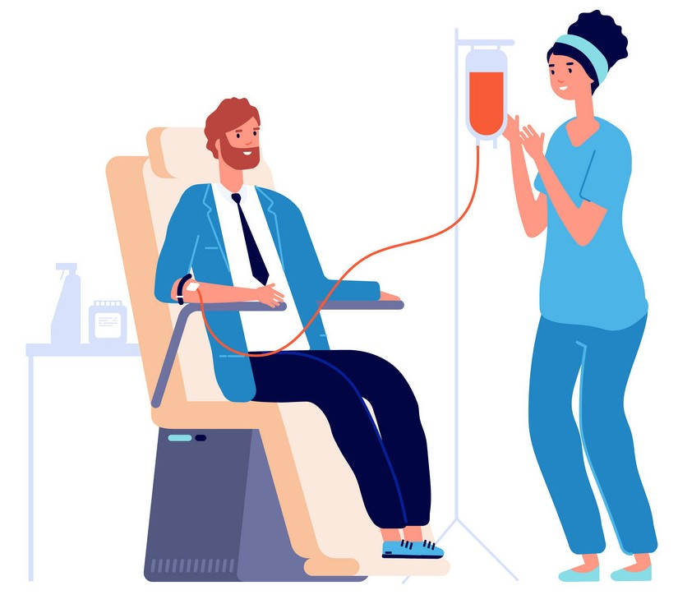
Welcome
Applicant and Donor
Background
User stories
Use case
Activity diagram
Sequence diagram
State diagram
Nurse
User stories
Use case
Activity diagram
Sequence diagram
State diagram
Administrator
User stories
Use case
Activity diagram
Sequence diagram
State diagram
Class diagram

Slide 3
Blood donation processing in Blood Bank
Apply to be a Donor
Send it to Stock
A person as a applicant can apply for blood donation and he will cross some filters to be a blood donor.
Administrator is controlling all processing between Donor and Nurse. When Blood has taken, Admin should send it to blood stock to share between hospitals.
When registering approved nurse will make an appointment to get test and if that is approved, donor can give blood donation.
Get blood donation

Slide 4


Applicant _User stories _Analyse _UML diagrams
As an Applicant:
I can choose my region first to get related info in my region.
I can change the language.
I can read about, how to be a blood donor.
I can see Blood Bank contact info.
I would know what I do after blood giving.
I can navigate the nearest blood station to me.
I would like to see common questions and answers.
I would like to see questions in different categories.
I can search keywords to find my same question.
I can share the answers with others via social media.
I would like to have special icon to change page for handicap persons.
Choice criteria:
Zoom in
Zoom out
High Contrast
Low contrast
Reset

Slide 5


Donor _User stories _Analyse _UML diagrams
As a Donor,
I would like to have all Applicant accessibility.
I would like to be notified when I am accepted as a Donor.
I can change my password.
I can see my contact details on my page.
I should fill in a health declaration before each blood donation.
I would like to see my blood test details.
I can request to rebook my donation time.
I can print my booked time.
I would like to be notified when I can give blood again.
I can see my blood donations history.

Slide 6
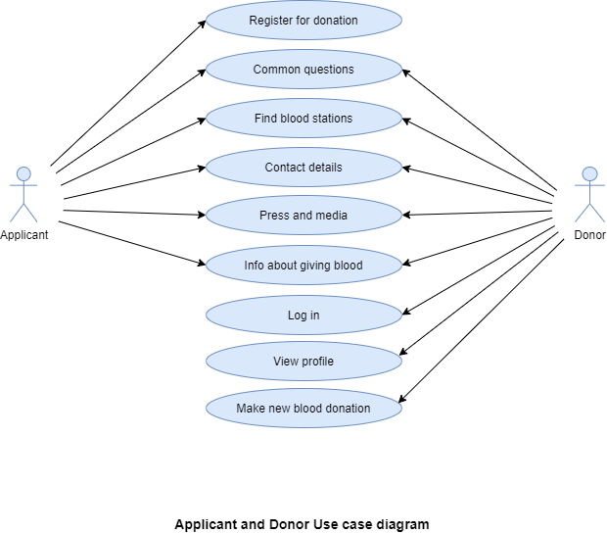
Applicant & Donor _Use case Diagram

Slide 7
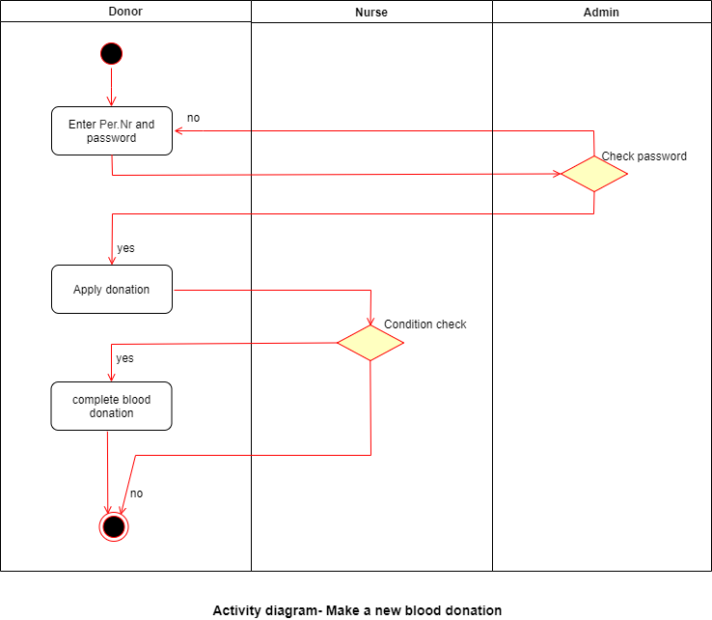
Donor _Activity Diagram

Slide 8
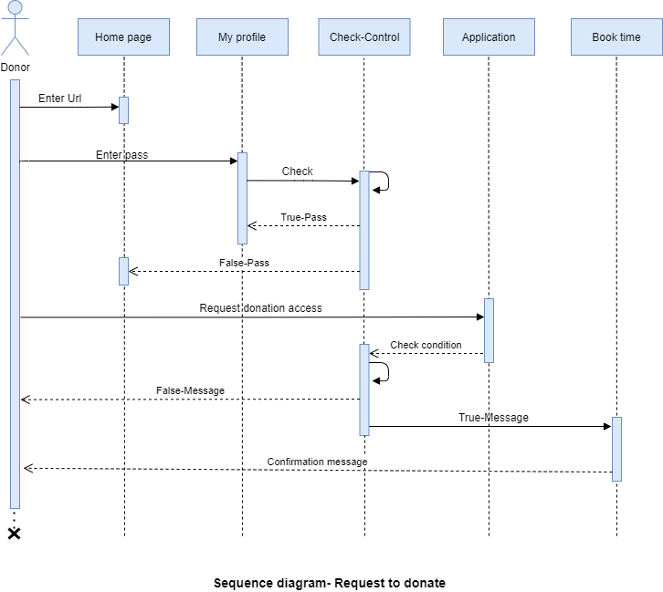
Donor _Sequence Diagram

Slide 9
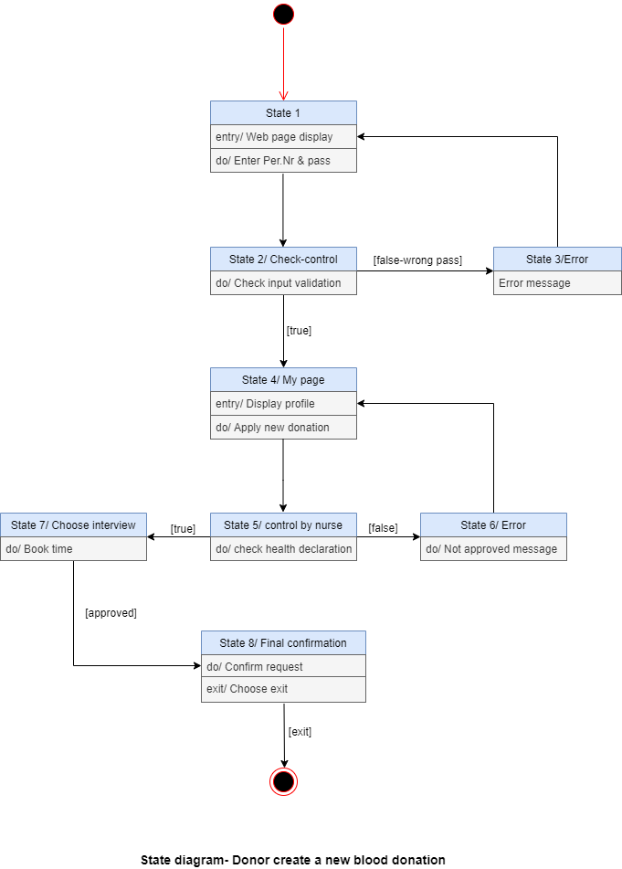
Donor _State Diagram

Slide 10

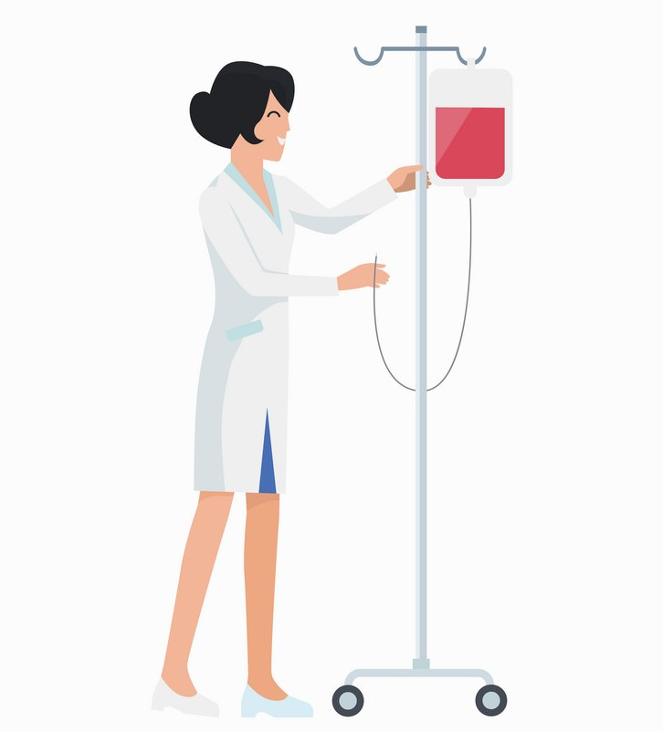
Nurse _User stories _Analyse _UML diagrams
As a Nurse I want to be able to
Login to the system
View the requests.
See the donor appointment time.
change the appointment time.
Notify the donor if appointment time changes.
view the donor profile.
view donor medical history( previous tests.
I should insert in the system the donor blood group after testing.
Able to approve or reject donor health declaration.
To have access to the automated unique ID number.
I want to see if the donor gave the blood donation history.
I want to be able to enter fills how much blood donation given
Enter if Donor is not able to donate blood due to any reason.
Reschedule the appointment of a donor.
Able to contact other users.
Able to print donor information.
Get notification/ updates from the system.

Slide 11
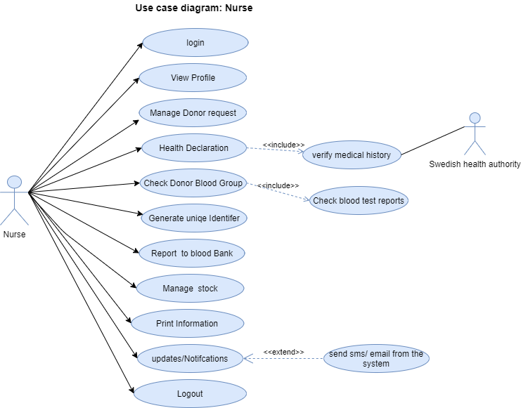
Nurse _Use case diagram

Slide 12
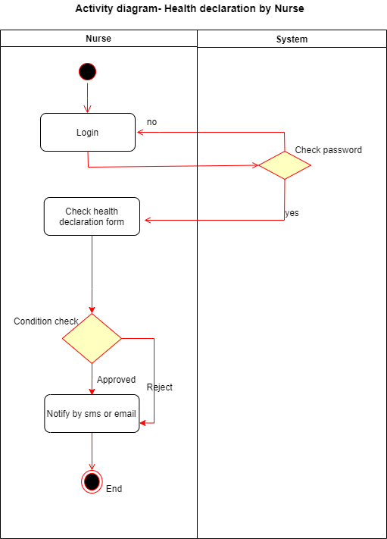
Nurse _Activity Diagram

Slide 13
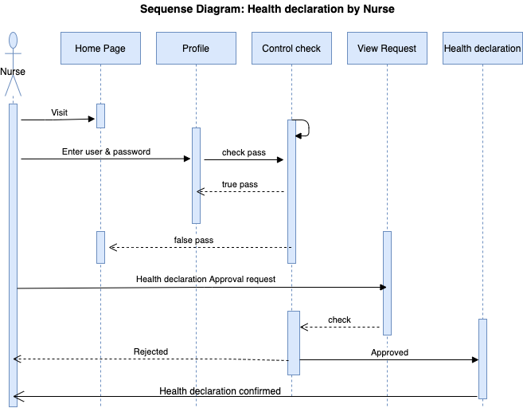
Nurse _Sequence diagram

Slide 14
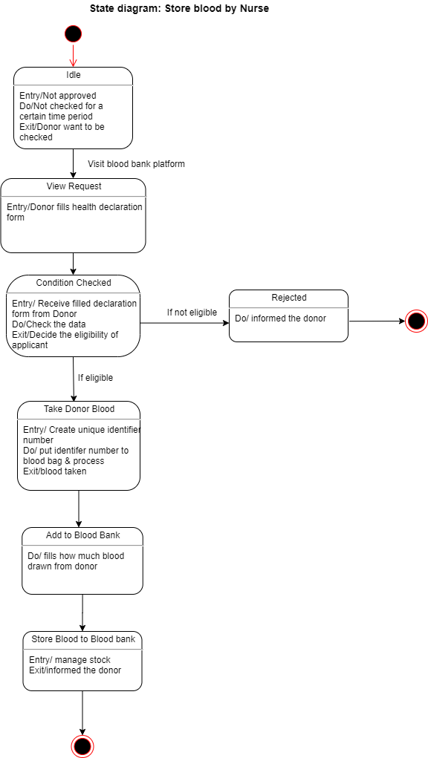

Nurse _State diagram

Slide 15


Admin-istrator _User stories _Analyse _UML diagrams
As an Administrator I should be able to
login to the system
get error message if the login credentials entered is incorrect
create new user
delete an existing user
view user details
edit user details
assign user status such as applicant, donor, nurse and admin.
restrict the profile field which an user can change or cannot change by himself/herself
check a Swedish person’s contact details by person number and validate if the person number exists
read a Swedish person’s medical background
register an applicant
delete an applicant
get validation message regarding if an applicant is already registered by person number
see the applicant’s interview result and the blood test result
approve an applicant as a donor
reject an applicant
send SMS to an user directly from the system

Slide 16
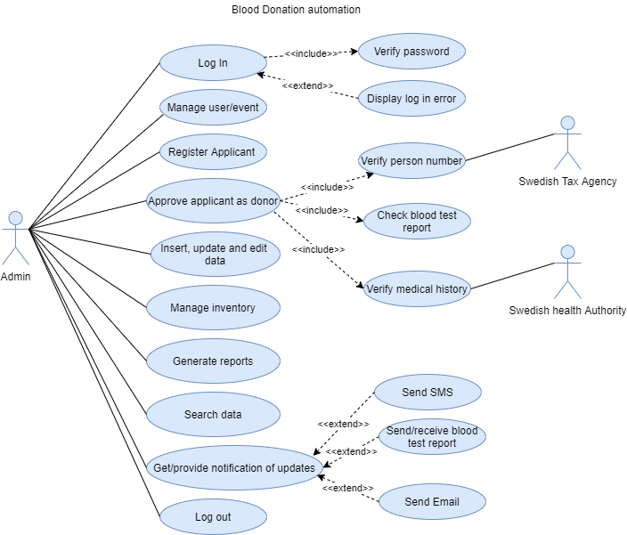
Admin-istrator _Use case diagrams

Slide 17
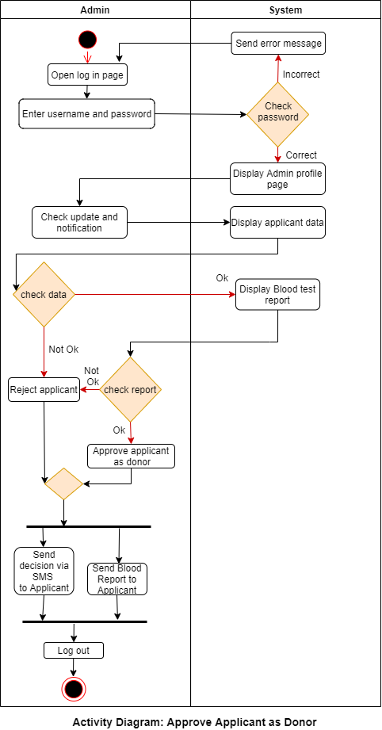
Admin-istrator _Activity diagrams

Slide 18
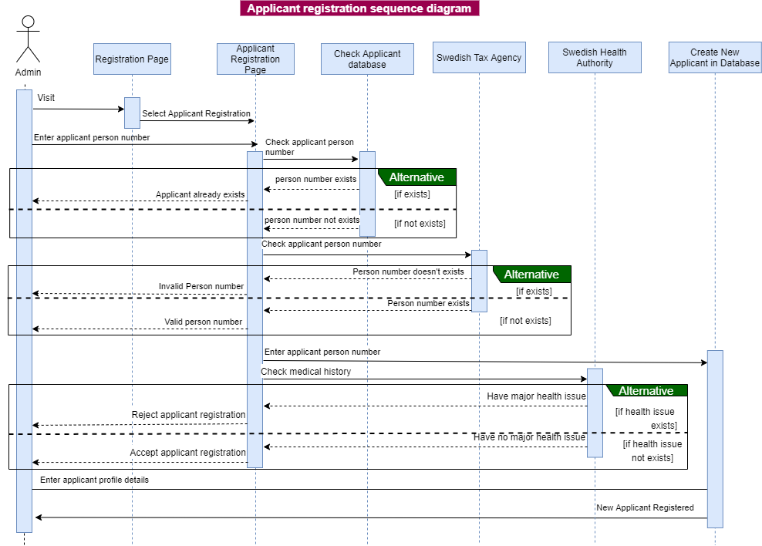
Admin-istrator _Sequence diagrams

Slide 19
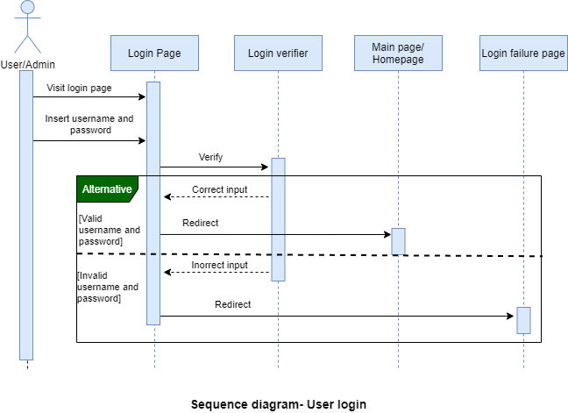
Admin-istrator _Sequence diagrams

Slide 20
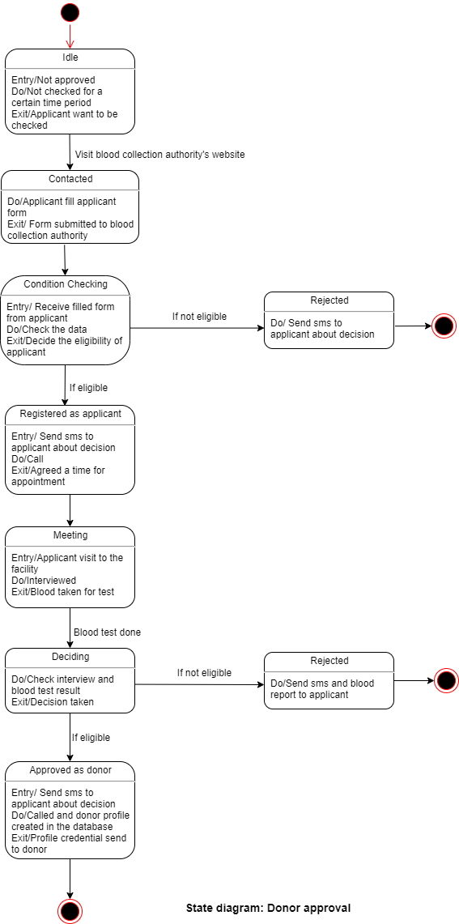

Admin-istrator _State diagrams

Slide 21
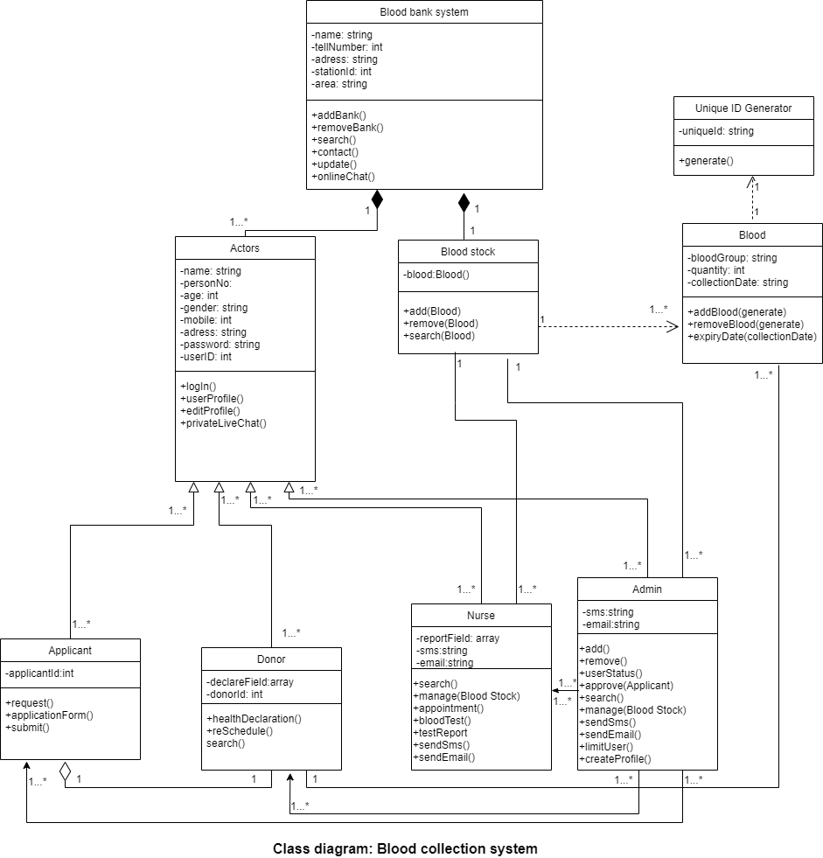

Class Diagram

Slide 22

Thank You for your time QUESTIONS? _ALi _Sadia _Rashida

